Slide 1
Binary search trees
and K-dimensional trees

Slide 2
Trees and binary trees
A tree is a connected graph (no island) with no cycles.
We’ll use rooted tree (only one node has no parent),
specifically with 2 children (max) on each node.

Slide 3
13
What is a binary search tree ?
There’s only one rule : for each node
- all the nodes under its left child have lower values
- all the nodes under its right child have higher values
The only way to add a node is to add a leaf.
There are multiple types of binary search trees,
what differs between them are the methods for
adding and removing nodes.
For example, a balanced tree will optimize its structure
to have equal branches sizes to optimize search time.
6
16
5
9
14
20
2
7
12
17
25

Slide 4
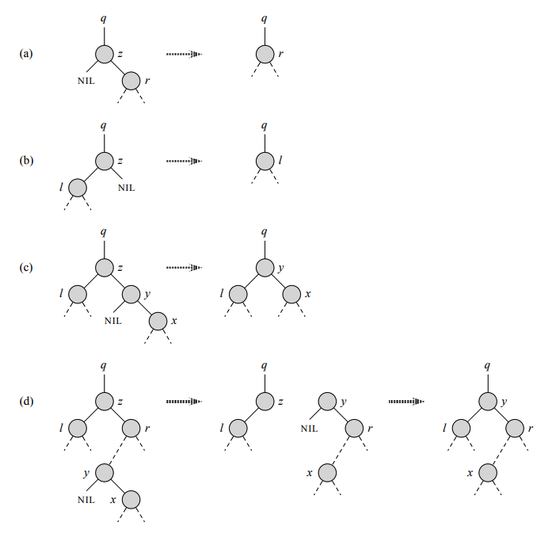
13
What is a binary search tree ?
There are algorithms to remove nodes but it’s not really important here.
6
16
5
9
14
20
2
7
12
17
25

Slide 5
13
What it’s for ?
They’re used to search for points in logarithmic time,
the example I’ll use is searching for a point close to given coordinates.
In 1D, the algorithm is pretty easy :
try to find the node with the value closer to 6.6 in this tree.
6
16
5
9
14
20
2
7
12
17
25

Slide 6
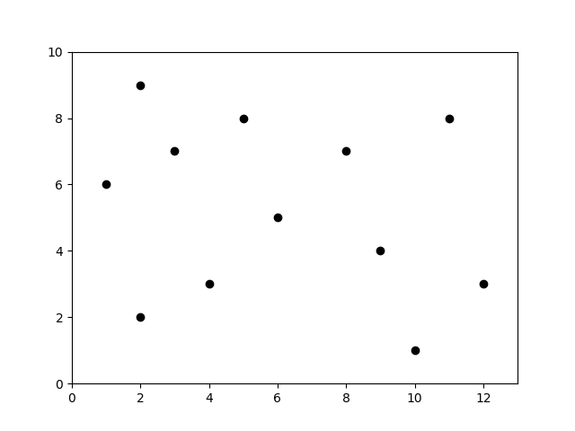
Multi dimensionnal BST : KD-trees
That’s where it gets complicated : here we’ll see 2D-trees
but the search algorithm works in any dimension.
The tree is made so that each level divides a dimension.
We’ll build the tree for this scatter :

Slide 7
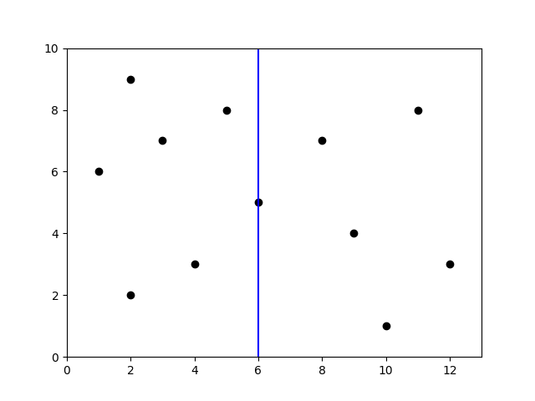
(6, 5)
x
Multi dimensionnal BST : KD-trees
First, we cut the plan in half through the point in the middle of the x axis :

Slide 8
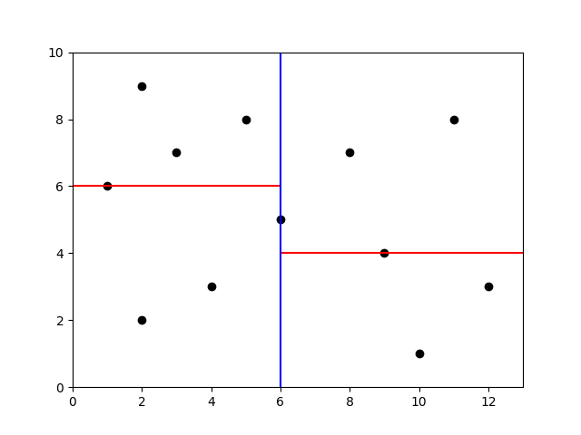
(6, 5)
x
A 2D-tree
Then we cut the left part and the right part in halves :
(1, 6)
(9, 4)
y

Slide 9
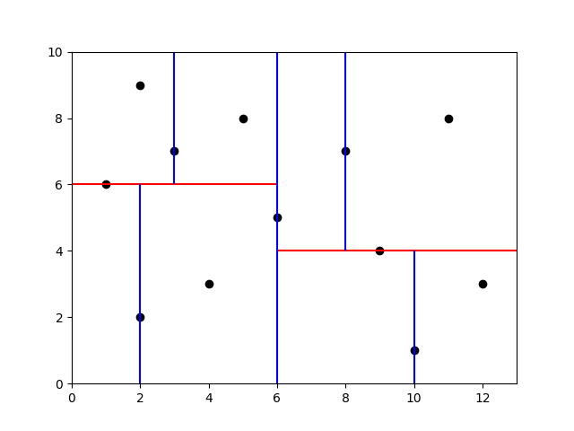
(6, 5)
x
A 2D-tree
And then rince and repeat until all the points are in the tree :
(1, 6)
(9, 4)
y
(2, 2)
(3, 7)
(8, 7)
x
(10, 1)

Slide 10
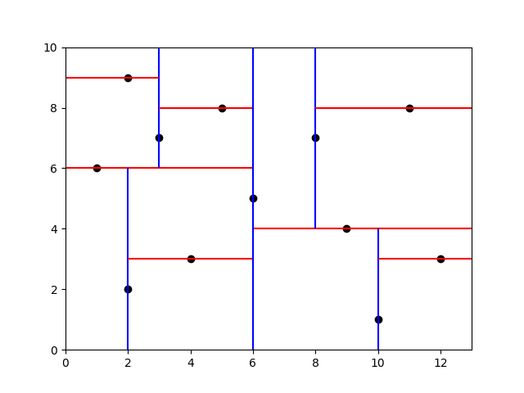
(6, 5)
x
A 2D-tree
And then rince and repeat until all the points are in the tree :
(1, 6)
(9, 4)
y
(2, 2)
(3, 7)
(8, 7)
x
(10, 1)
(4, 3)
(2, 9)
(5, 8)
y
(12, 3)
(11, 8)

Slide 11
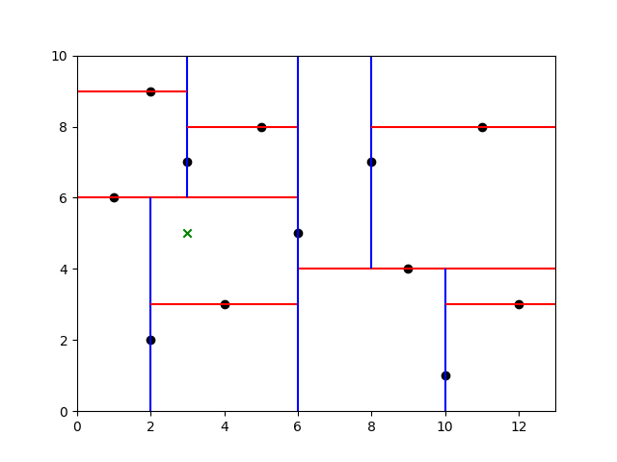
(6, 5)
x
A 2D-tree
Now we can search which point of the scatter
is closer to given coordinates. Let’s go through the example
of the point (3, 5) with euclidian norm.
(1, 6)
(9, 4)
y
(2, 2)
(3, 7)
(8, 7)
x
(10, 1)
(4, 3)
(2, 9)
(5, 8)
y
(12, 3)
(11, 8)

Slide 12
exercises :
Easy :
https://www.hackerrank.com/challenges/binary-search-tree-insertion/problem?isFullScreen=true
Medium :
https://www.hackerrank.com/challenges/binary-search-tree-lowest-common-ancestor/problem?isFullScreen=true
Hard :
https://www.hackerrank.com/challenges/is-binary-search-tree/problem?isFullScreen=true

